Slide 1

Lecture 10– Social media and network analysis
Programming for Intelligent Web Services and Applications
Wenli Yang
yang.wenli@utas.edu.au

Slide 2
Unit Content
Programming for Intelligent Web Services and Applications
Web Programming
Intelligent Technologies
Advanced Web Research
Week1
Week5
Week9
Web Architecture
Classification and Clustering
Indexing and Ranking
Week2
Week6
Week10
Web Service Programming I
Natural Language Processing
Social media and network analysis
Week3
Week7
Week11
Web Service Programming II
Opinion Mining and Analysis
Conversational Chatbot
Week4
Week8
Week12
Web Monitoring and Mining
Recommendation Algorithms
Crowdsourcing
Week 13 – Unit Review (for Exam)

Slide 3
In Previous Lectures
In previous lectures, we learning the followings:
Web Programming
Web API
Web crawling
Intelligent Technologies
Data mining: Classification and Clustering
Natural language processing
Opinion Mining
Recommender System
And, we studied advanced web research field 1 in last lecture ☺
Web Search Engine

Slide 4
Today’s Lecture
Emerging Research Field 2 : Social media and networks!
Overview: social media trends
Social Network Analysis
Applications of Mining social media
Community mining
Information diffusion and provenance
Conclusions

Slide 5

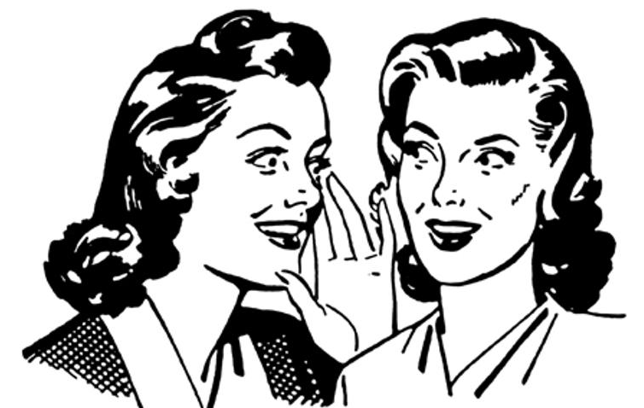
Communication Approach Before Web
Before Web
How can you receive the information?
How can you share information (communicate) with others?
Notes:
Newspaper, radio,
write letter or face-to-face talking

Slide 6



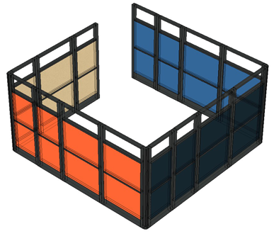






After Web – Evolution of Web
Web 1.0 “The Web”
Web 2.0 “Social Web”
Web 3.0 “Semantic Web”
Personalised Recommendation
Michael
Michael
Michael
write
write
read
write
read
Michael’s cubicle
Michael’s Home
Company
Artificial Intelligence
read
read
write
read
write
Other Users

Slide 7
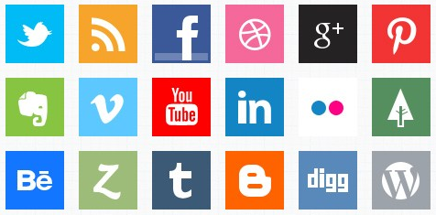
Social Media
Web-based service that support social activities of the users.
Build on the ideological and technical foundations of Web 2.0
Allow the users to create and exchange the user-generated content.
Still be the important asset in Web 3.0

Slide 8
Social Media
Online social networking (e.g., Facebook, LinkedIn)
Microblogging (e.g., Twitter)
Social news (e.g., Digg, Reddit)
Media sharing (e.g., YouTube)
Opinion, reviews, and ratings (e.g., Epinions, Yelp)
Answers (e.g., Yahoo! answers, Wiki)…

Slide 9
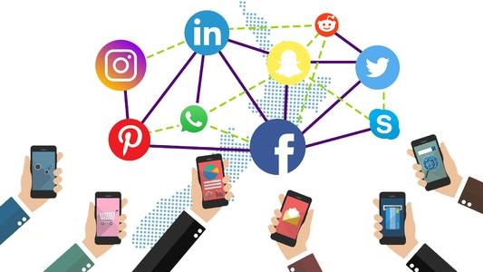
Social Media
The interaction among people in which they share and exchange information or idea in virtual community or network.
The future of communication, a countless array of internet, based tools that increase or enhance the sharing of information.

Slide 10
Social media data
Social media has generated unprecedented amount of social data.
Social media data:
Vast, noisy, unstructured, and dynamic in nature
→ Difficult to analyse
Data mining techniques(e.g. Classification or Clustering) have been used to analyse social media data

Slide 11
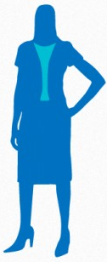
Users in Social Media
A user in social media can be described by various attributes
gender, age, interests, job, education, etc.
User’s profile can be either public or private
Data mining example (clustering):
E.g. Users who have same attributes can be grouped as a subgroup (e.g., same age, same location, etc.).
The subgroup can be used to extract preferences
gender
age
interests
job
education
…

Slide 12
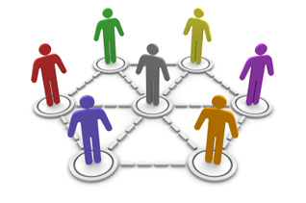
Relations (Ties) in Social Media
The users in a social media have a relation with other users by posting articles, images, and videos; by writing comments, etc.
The number of actions forming the relations may show the degree of relation between the users.

Slide 13
Network in Social Media
Social media data can be represented by a network graph, consisting of users as nodes and relations between them as Ties.
Relation Characteristics:
All-or-nothing (e.g., either friends or not)
Degree of relation
Can be classified into friends, family, acquaintances, or none
Real number
The fraction of the average day that two people spend talking to each other
User A
Ties (Relation)
User B
User C

Slide 14
Social Network Analysis
Social network analysis (SNA) is a theory that analyses social network structures by using network and graph aspects.
It characterise the network structure with social relationships (including nodes and ties)
Nodes: Individual actors(e.g. user) within the network
Ties: Relationships between the individuals, such as friendship, kinship, organizations, sexual relationships, etc.
User A
Ties (Relation)
User B
User C

Slide 15
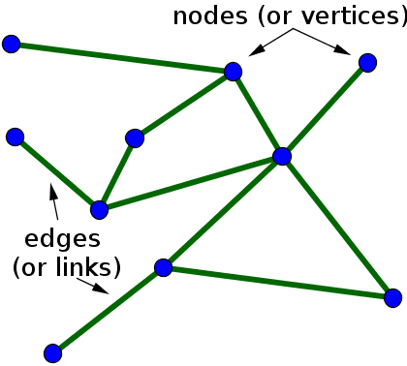
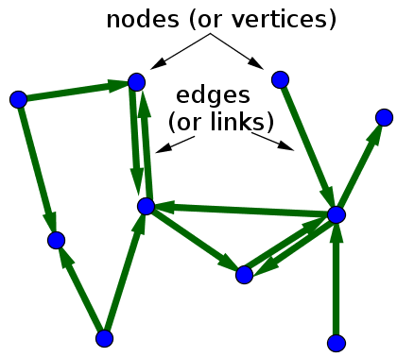
Network in Social Media (Social Network)
Social networks are naturally modelled as social graphs. Social graph can be classified into two categories:
Undirected graph (e.g. Facebook):
graph that objects are connected together, where all the edges are bidirectional (e.g., friends).
Directed graph (e.g. Google+):
graph that objects are connected together, where all the edges are directed from one vertex to another.
Undirected graph
Directed graph

Slide 16
Relationship Strength
Relationship strength calculation
How to calculate the strength of relationship between two users
How to identify strong/weak ties in the network
User A
?
User B
?
?
?
User C
User D
?

Slide 17
Relationship Strength
Relation strength represented by the ties weight. Ties weight can be calculated by using:
The frequency of interaction (communication)
The amount of flow (exchange)
The reciprocity in interaction or flow
(e.g. content of communication)
The structure of the nodes’ neighbourhood
(e.g. the number of common ‘friends’)
User A
30
User B
22
5
2
User C
User D
37
Tie list
Adjacency matrix
Vertex | Vertex | Weight
A | B | 30
B | C | 5
B | C | 22
B | D | 2
C | D | 37
Vertex | A | B | C | D
A | - | 30 | 5 | 0
B | 30 | - | 22 | 2
C | 5 | 22 | - | 37
D | 0 | 2 | 37 | -

Slide 18
Homophily
Homophily
Heterophily
Homophily is the tendency to relate to people with similar characteristics (status, beliefs, etc.)
It leads to the formation of homogeneous groups (clusters) where forming relations is easier
Extreme homogenization can act counter to innovation and idea generation
Heterophily is the opposite of homophily
Homophilous ties can be strong or weak
Strong
TIES
Weak
Transitivity
Bridging
CLUSTERING
Cliques
Interlinked groups
Social network

Slide 19
Transitivity
Homophily
Heterophily
Transitivity is a property of ties: if there is one tie between A and B and other between B and C, then in a transitive network A and C will also be connected
Strong ties are more often transitive; transitivity is therefore evidence for the existence of strong ties (but not a necessary or sufficient condition)
Transitivity and homophily together lead to the formation of cliques (fully connected clusters)
Strong
TIES
Weak
Transitivity
Bridging
CLUSTERING
Cliques
Interlinked groups
Social network

Slide 20
Bridging
Homophily
Heterophily
Bridges are nodes and edges that connect across groups
Facilitate inter-group communication, increase social cohesion, and help spur innovation
They are usually weak ties, but not every weak tie is a bridge
Strong
TIES
Weak
Transitivity
Bridging
CLUSTERING
Cliques
Interlinked groups
Social network

Slide 21
Centrality Measures
What is Centrality Measure? It is used to find key players in a social network
Centrality measures include the followings:
Degree
Betweeness
Closeness
Eigenvector

Slide 22
Interpretation of Measures
Centrality measure
Interpretation in social networks
Degree
Betweeness
Closeness
Eigenvector
How many people can this person reach directly?
How likely is this person to be the most direct route between two people in the network?
How fast can this person reach everyone in the network?
How well is this person connected to other well-connected people?
Notes:
Degree: In network of music collaborations: how many people has this person collaborated with?
Betweeness: In network of spies: who is the spy though whom most of the confidential information is likely to flow?
Closeness: In network of relations: how fast will an rumor spread from this person to the rest of the network?
Eigenvector: In network of paper citations: who is the author that is most cited by other well-cited authors?

Slide 23
Degree Centrality
Hypothetical graph
How many people can this person reach directly?
A node’s (in-) or (out-)degree is the number of links that lead into or out of the node
In an undirected graph they are of course identical
Useful in assessing which nodes are central with respect to spreading information and influencing others in their immediate ‘neighbourhood’
2
1
2
3
4
3
5
4
1
4
7
1
1
6

Slide 24
Paths and Shortest Paths
A path between two nodes is any sequence of non-repeating nodes that connects the two nodes
The shortest path between two nodes is the path that connects the two nodes with the shortest number of edges (also called the distance between the nodes)
In the example to the right, between nodes 1 and 4 there are two shortest paths of length 2: {1,2,4} and {1,3,4}
Other, longer paths between the two nodes are {1,2,3,4}, {1,3,2,4}, {1,2,5,3,4} and {1,3,5,2,4} (the longest paths)
Shorter paths are desirable when speed of communication or exchange is desired
Hypothetical graph
1
2
3
5
4
Shortest path(s)

Slide 25
Betweeness Centrality
How likely is this person to be the most direct route between two people in the network?
For a given node v, calculate the number of shortest paths between nodes i and j that pass through v, and divide by all shortest paths between nodes i and j
Sum the above values for all node pairs i,j
Shows which nodes are more likely to be in communication paths between other nodes
Higher network importance = higher Betweeness
Hypothetical graph
1
2
3
4
5
7
6
Notes:
(

Slide 26
Betweeness Centrality
For node 3: (14)
(1,3,5) (1,3,5,6) (1,3,5,7)
(2,3,4)
(4,3,2) (4,3,5) (4,3,5,6) (4,3,5,7)
(5,3,1) (5,3,4)
(6,5,3,1) (6,5,3,4)
(7,5,3,1) (7,5,3,4)
For node 5: (18)
(1,2,5,6) (1,2,5,7)
(2,5,6) (2,5,7)
(3,5,6) (3,5,7)
(4,3,5,6) (4,3,5,7)
(6,5,2,1) (6,5,2) (6,5,3) (6,5,3,4) (6,5,7) (7,5,2,1) (7,5,2) (7,5,3) (7,5,3,4) (7,5,6)
Hypothetical graph
1
2
3
4
5
7
6
Node 5 has higher betweenness than Node 3
Notes:
(

Slide 27
Closeness Centrality
Hypothetical graph
Calculate the mean length of all shortest paths from a node to all other nodes in the network (i.e. how many hops on average it takes to reach every other node)
Take the reciprocal of the above value so that higher values are ‘better’ (indicate higher closeness) like in other measures of centrality
It is a measure of reach, i.e. the speed with which information can reach other nodes from a given starting node
1
2
3
5
4
7
6
Notes:
1: 6/12=0.5
2: 6/9=0.67
3: 6/8=0.75

Slide 28
Closeness Centrality
Hypothetical graph
For node 1, all shortest paths are:
(1,2), (1,3) (1,3,4) (1,3,5) (1,3,5,6) (1,3,5,7)
6/(1+1+2+2+3+3) =6/12=0.5
For node 2, all shortest paths are:
(2,1) (2,3) (2,3,4) (2,5) (2,5,6) (2,5,7)
6/(1+1+2+1+2+2)=6/9=0.67
…
0.5
1
2
0.67
0.75
3
5
0.75
0.46
4
7
0.46
0.46
6
Nodes 3 and 5 have the highest (i.e. best) closeness
Notes:
1: 6/12=0.5
2: 6/9=0.67
3: 6/8=0.75

Slide 29
Eigenvector Centrality
Hypothetical graph
How well is this person connected to other well-connected people?
A node’s eigenvector centrality is proportional to the sum of the eigenvector centralities of all nodes directly connected to it
In other words, a node with a high eigenvector centrality is connected to other nodes with high eigenvector centrality
This is similar to how Google ranks web pages: links from highly linked-to pages count more
Useful in determining who is connected to the most connected nodes
1
2
3
5
4
7
6

Slide 30
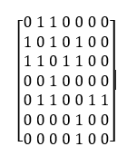
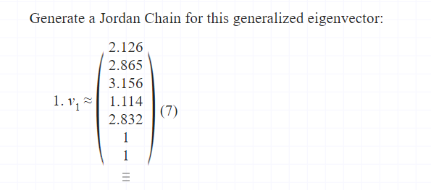
Eigenvector Centrality
Hypothetical graph
Based on degree centrality, first construct the matrix:
Eigenvector centrality you can use online matrix calculator: https://matrixcalc.org/en/vectors.html
2.126
1
2.865
2
3.156
3
5
2.832
1.114
4
7
1
1
6
Node 3 has the highest eigenvector

Slide 31
Identifying Sets of Key Players
Node 10 is the most central according to degree centrality
However, nodes 3 and 5 together will reach more nodes
Moreover the tie between them is critical; if severed, the network will break into two isolated sub-networks
It follows that other things being equal, players 3 and 5 together are more ‘key’ to this network rather than node 10
1
0
2
10
9
3
5
4
8
6
7

Slide 32
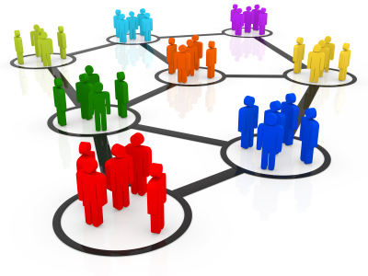
Community on Social Media
A community is a group, in which members interact more frequently than with those outside the group.
A.k.a. group, cluster, etc.
Community mining on social network has attracted more and more attentions in recent years.

Slide 33
Community Mining
Community Formation
What are the structural features that inﬂuence whether a given individual will join a particular group?
Community Detection
How to detect a community in a network?

Slide 34
Community Formation
Closely related to the diffusion of innovation, which seeks to explain how, why, and at what rate new ideas and technology spread through cultures (Everett Rogers, 1962).
E.g., How does one’s probability p of joining a group depend on the number of friends k that one already has in the group?

Slide 35
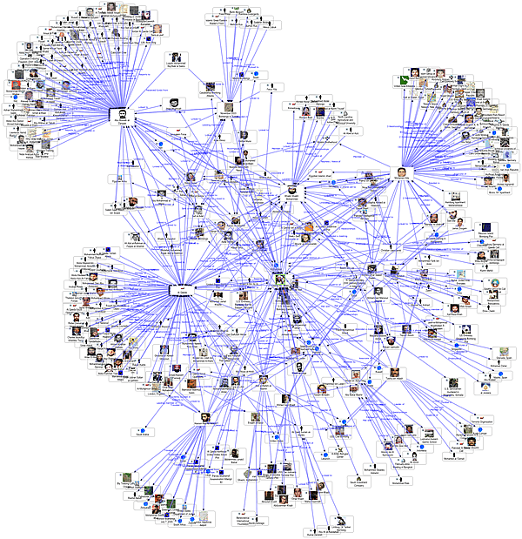
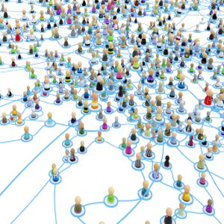
Community on Social media

Slide 36
Community Detection
Communities on the web might represent pages of related topics.
Community can be considered as a summary of the whole network thus easy to visualize and understand.
Sometimes, community can reveal the properties without releasing the individual privacy information.

Slide 37
Community Detection Methods
Community Detection
Node- centric
Group-centric
Network-centric
Hierarchy-centric

Slide 38
Community Detection Methods
Node-centric community detection: each node satisfies certain properties such as complete mutuality, reachability, node degrees, frequency of within and outside ties, etc. (e.g., cliques)
Group-centric community detection: Consider the connections within a group as a whole. The group has to satisfy certain properties (e.g., minimum group densities) without zooming into node-level
Network-centric community detection: groups are formed based on partition of network into disjoint sets. Cluster (e.g., k-means clustering) the groups based on vertex similarity → the simliarity of their neighbourhood
Hierarchy-centric community detection: build a hierarchical structure of communities (e.g., divisive clustering and hierarchical clustering). Recursively remove the “weakest” tie.

Slide 39
References
Gundecha, P. and H. Liu (2012). Mining Social Media : A Brief Introduction. Tutotrials in Operations Research, The Institute for Operations Research and the Management Sciences (INFORMS).
Backstrom, L., D. Huttenlocher, et al. (2006). Group formation in large social networks: membership, growth, and evolution. SIGKDD 2006, ACM: 44-54.
Rajaraman, A., J. Leskovec, and J.D. Ullman, Chapter 10 Mining Social-Network Graphs. Mining of Massive Datasets. 2011.

Slide 40
In this Week
Learn how to combine APIs
(e.g., integrate web speech API and Geolocation API)
Learn how to combine API and AI techniques
(e.g., integrate web speech API and NLP)
Notes:
Memory Binding Test

Slide 41
Next week…
Lecture: Conversational Chatbot
Tutorial: Combine APIs and AI techniques
Weekly quiz: we will take a quiz about what we learn in week 10
(Social network and analysis)

